Slide 1


Slide 2




THE TEAM
Detomaso
Riccardo
Iannone
Alessandro
Silvestri
Giovanni
Tangari
Mauro

Slide 3

THE PROJECT
The project aims to provide a platform, based on an authorized blockchain, to save, immutably, the path of a drone or a flock of drones.

Slide 4
THE PROJECT
The ultimate goal would be to integrate a simulation, based on the Digital Twin, to test the proper integration of the drone with the data saved in the blockchain.

Slide 5
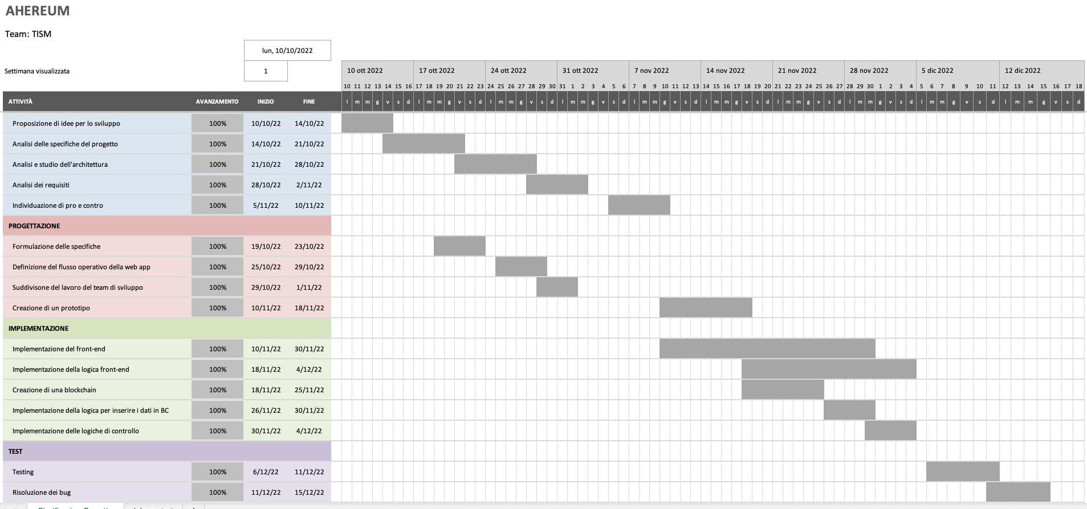
GANTT CHART

Slide 6
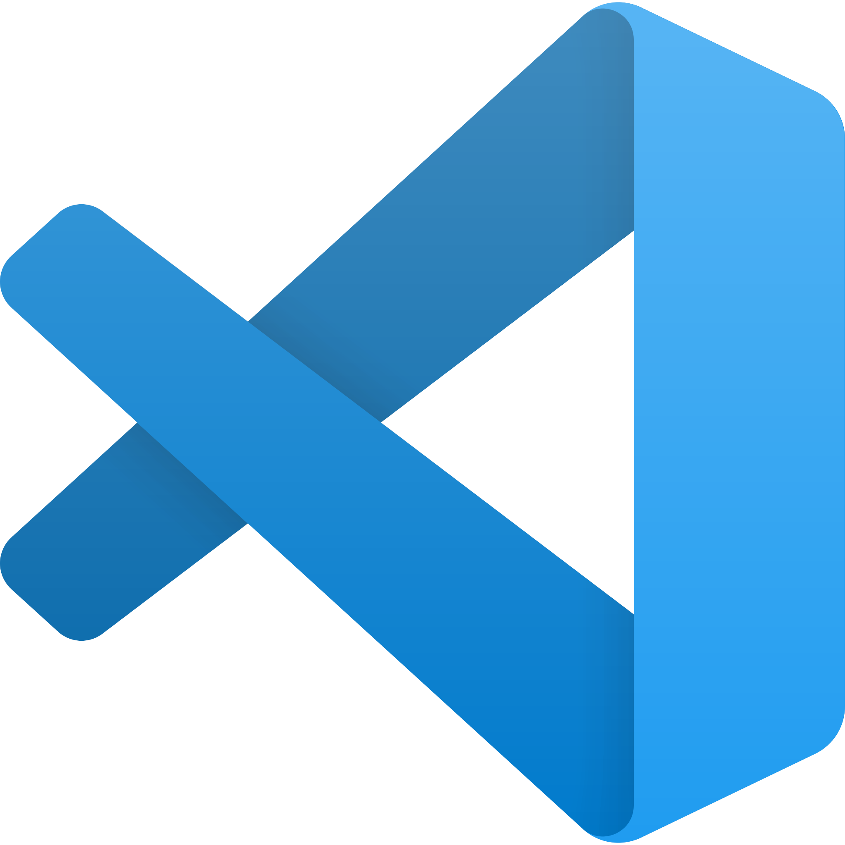

EDITOR & REPOSITORY
Visual studio code
GitHub

Slide 7
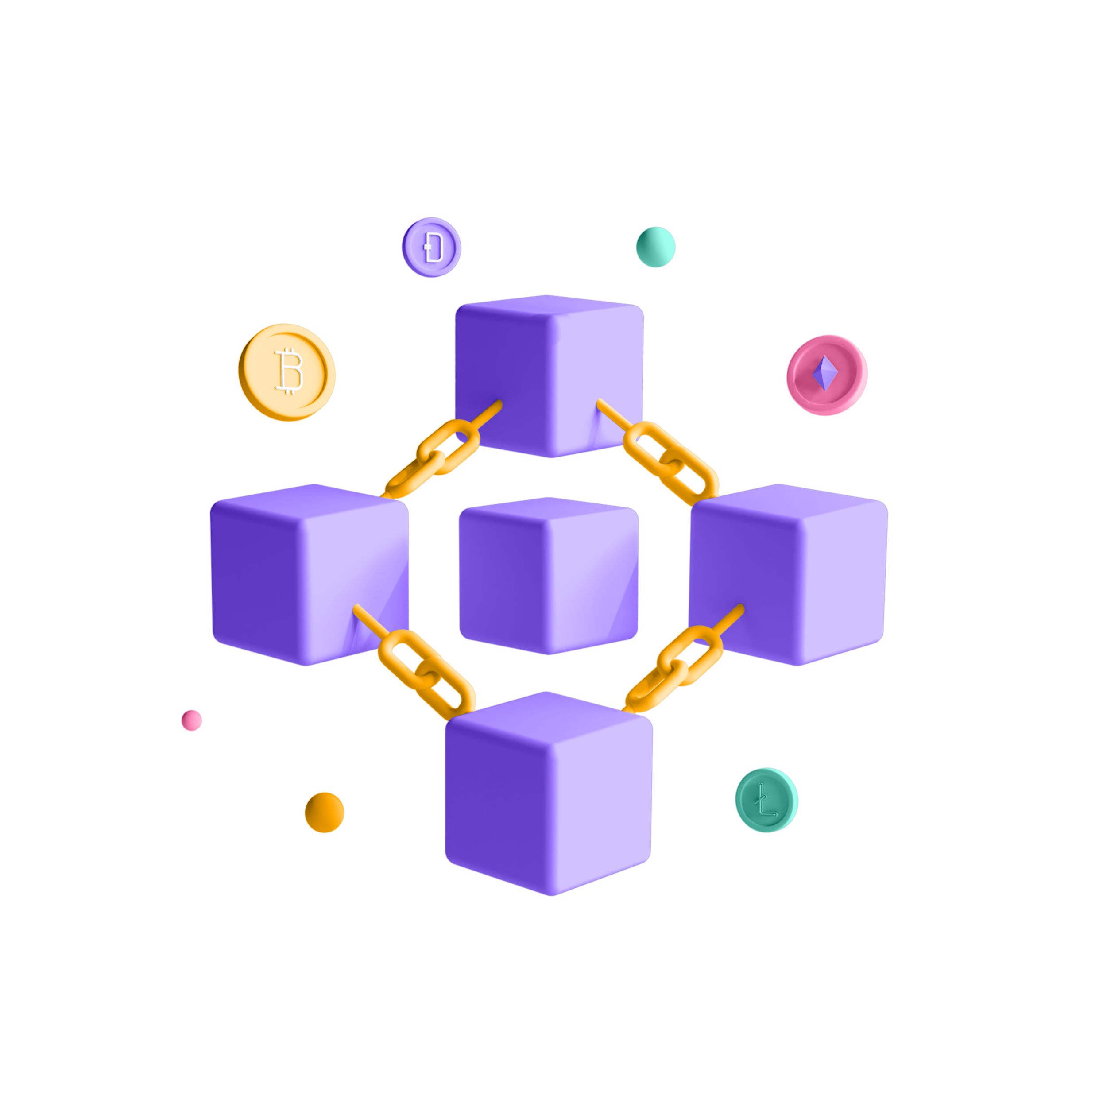
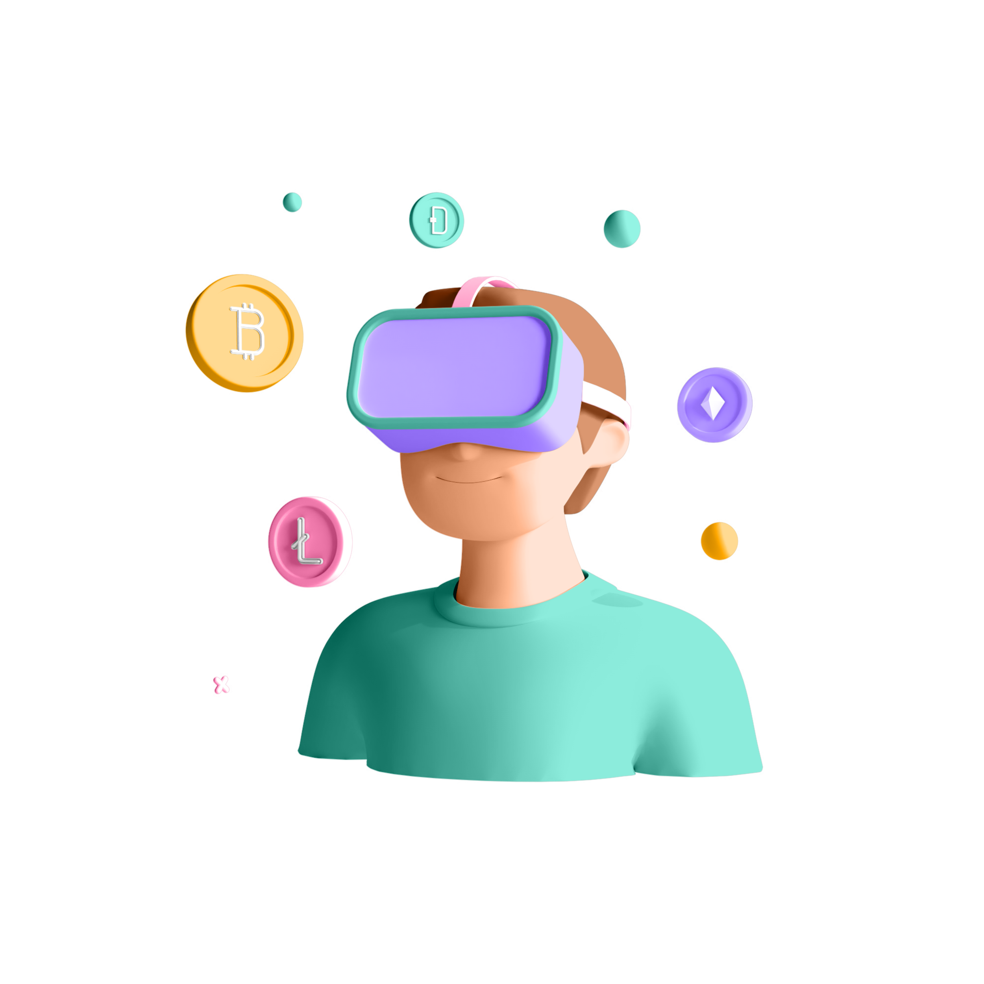
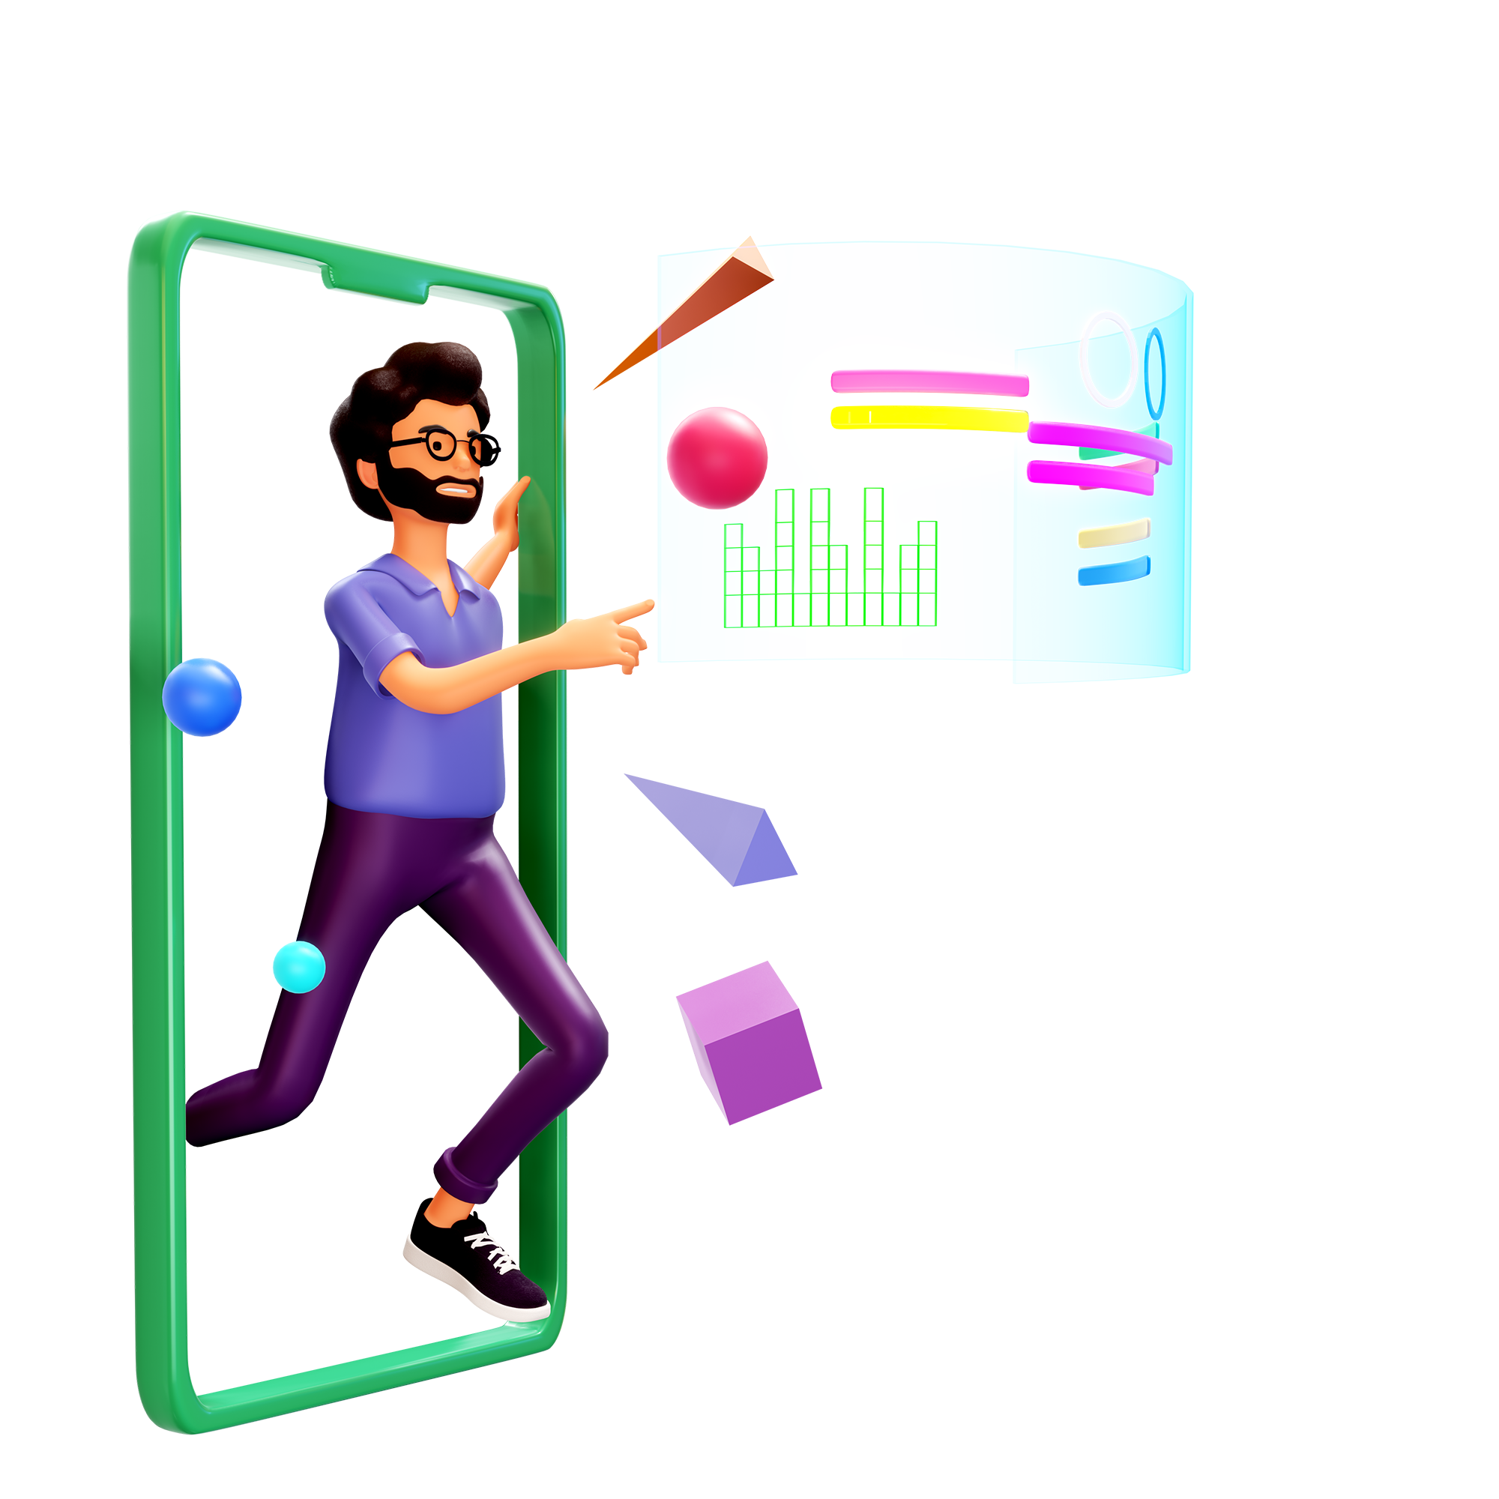
WHAT HAVE WE DONE?
Front-end
Web-3
Blockchain

Slide 8
FRONT-END
It allows the coordinates of the drone to be entered, either through a map or by simply typing them into a text box.

Slide 9
WHAT HAVE WE DONE?
Front-end
Web-3
Blockchain

Slide 10
WEB-3
The collection of JavaScript libraries that enable communication with the blockchain to store data in the latter.
Notes:
Web3: is a recent development of the Internet concept. A new idea of a totally decentralized web, based on novel protocols and, most importantly, blockchain technology.

Slide 11
WHAT HAVE WE DONE?
Front-end
Web-3
Blockchain

Slide 12
BLOCKCHAIN
Blockchain implementation enables written data to be made immutable and absolute, so that the highest level of security can be achieved in the management of the routes of aircraft.

Slide 13






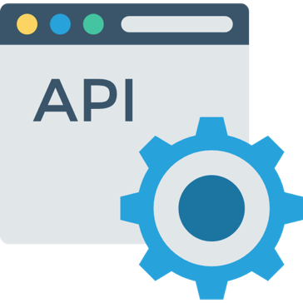


ARCHITECTURE
Web front-end
Data verification
Transaction
Blockchain
Smart contract
Blockchain management
Sensors
Simulator

Slide 14
DATA VERIFICATION
Metamask: MetaMask is a cryptocurrency wallet that enables users to access the Web 3 ecosystem of decentralized applications.
Solidity: is the main language used for programming Smart Contracts on Ethereum.
Notes:
Goerli

Slide 15
DATA VERIFICATION
Structure of the smart contract
struct Path {
uint id;
string pathText;
bool isDeleted;
}
}
function addCu(string memory taskText, bool isDeleted)
function getMyPath()
function deletePath(uint taskId, bool isDeleted)

Slide 16
ARCHITECTURE
Web front-end
Data verification
Transaction
Blockchain
Smart contract
Blockchain management
Sensors
Simulator

Slide 17
FRONT-END
Why we choose React?
simple, intuitive, and fast-learning JavaScript programming language;
component representation results in API calls to React that intervene as quickly and efficiently as possible on the DOM to create the necessary elements;
creation of "responsive" web apps, i.e., whose design can dynamically adapt to the size of the display on which the application is viewed.
Notes:
React is an open source JavaScript library maintained by Meta
for creating component-based user interfaces.
It is designed to enable, in a simple way, the development of applications with a "cross-platform" methodology, thus able to run on PCs, smartphones and tablets.

Slide 18
CONNECTION TO METAMASK
async function connectWallet() {
try {
const { ethereum } = window
if (!ethereum) {
console.log("MetaMask not detected");
return;
}
let chainId = await ethereum.request({ method: 'eth_chainId' })
const goerliChainId = '0x5';
if (chainId !== goerliChainId) {
return;
} else {
}
const accounts = await ethereum.request({ method: 'eth_requestAccounts' })
console.log(accounts)
} catch (error) {
}
}

Slide 19

GET DATA FROM BLOCKCHAIN
const getAllCus = async () => {
try {
const { ethereum } = window
let text = '';
if (ethereum) {
const provider = new ethers.providers.Web3Provider(ethereum);
const signer = provider.getSigner();
const TaskContract = new ethers.Contract(
TaskContractAddress,
TaskAbi.abi,
signer
)
let allCus = await TaskContract.getMyPath();
setPath(allPath);
if (allPath.length === [...todos].length) {
isLoad = true;
} else {
isLoad = false;
}
for (var i = 0; i < allPath.length; i++) {
text = allPath[i][‘pathText']
const obj = JSON.parse(text)
console.log(obj) }
} ...

Slide 20
GO LIVE
http://localhost:3000/

Slide 21

FUTURE DEVELOPEMENTS
Integration of a map thanks to which the user can select a cabin from those available, displaying its geographical location;
API integration thanks to which the Web App is able to interact with a real drone for information exchange;
Integration of a private, authorized blockchain to ensure confidentiality of data.

Slide 22



THANK YOU FOR YOUR ATTENCTION

